Slide 1
Machine Fault Diagnosis ai agent
IBM HACKATHON PROJECT
Presented By:
Student name : Vipin Shivhare
College Name & Department : Kamla Nehru Institute of Technology Sultanpur (U.P.)
B.Tech in Mechanical Engineering

Slide 2
OUTLINE
Problem Statement
Technology used
Wow factor
End users
Result
Conclusion
Git-hub Link
Future scope
IBM Certifications

Slide 3
Problem Statement
The challenge in modern manufacturing, small and medium-sized industries face frequent machine failures in lathes, mills, pumps, etc. leading to downtime, unsafe incidents, and high maintenance costs. Operators struggle to diagnose issues based on symptoms like vibrations, overheating, or odd noises. They often ask:
“Why is my CNC machine vibrating too much?”
“What could cause overheating in a hydraulic pump?”
Technicians often rely on a combination of experience and limited documentation to diagnose faults, which can be time-consuming and inefficient. The goal of this project is to develop an Agentic AI system that acts as a proactive virtual diagnostic assistant. This agent will interpret real-time machine data such as temperature, vibration, and unusual noise to quickly identify potential faults, provide actionable maintenance recommendations, and suggest critical safety precautions, thereby reducing downtime and improving workplace safety.

Slide 4
Technology used
This project is built using a combination of IBM Cloud Lite services and the IBM Granite AI model, providing a robust, yet cost-effective, platform for development and deployment.
Agentic AI Framework: The agent is designed to be more than a simple chatbot. It uses a decision-making loop to determine if it needs to perform an action (e.g., retrieve data from a simulated sensor) before generating a response.
IBM Granite-3.0-8B-Instruct Model: This is the core Large Language Model (LLM). It's a foundational model specifically designed for enterprise applications. It will be fine-tuned or prompted to excel at:
Reasoning: Interpreting sensor data and correlating it with known machine failure modes.
Generation: Creating clear, step-by-step diagnostic and maintenance instructions.
IBM Cloud Lite Services: The free tier of IBM Cloud offers essential components for this project:
IBM Cloud Functions: Used to host the "tools" that the agent can call. For example, a function could simulate an API call to a sensor to retrieve current vibration data.
IBM Cloud Object Storage: Serves as a simple knowledge base to store machine-specific documents, maintenance manuals, and a database of known fault signatures.
IBM Watson Assistant (Optional): Can be used to build the initial conversational interface, providing a front-end for user interaction.

Slide 5
IBM cloud services used
IBM Cloud Watsonx.AI Studio
IBM Cloud WatsonxAI runtime
IBM Cloud Agent Lab
mistral – large model
Deployment

Slide 6
Wow factors
The project's key differentiator is its agentic reasoning capability and action-oriented intelligence. Instead of simply providing generic advice, the agent actively processes data, combining its extensive knowledge with real-time sensor information. The wow factor is the transformation of a passive chatbot into an active "virtual mechanic" that can diagnose, explain, and recommend solutions. It provides a new level of intelligent automation to small businesses that may not have dedicated diagnostic teams.
Agentic AI with Root-Cause Analysis: Answers complex queries (e.g., “What’s causing these abnormal vibrations?”) using a blend of LLM reasoning and real sensor data.
Multimodal Fault Detection: Supports text, sensor time series, and optionally audio inputs.
Real-Time, Proactive Alerts: Detects faults before breakdowns, and provides actionable advice—reducing downtime and preventing accidents.
Fine-Tuned IBM Granite Model: Offers explainable, industry-specific answers with suggested fixes and safety steps.

Slide 7
End users
The primary end users are:
Maintenance Technicians: The first responders to machine faults, who need quick, on-the-spot diagnostic assistance.
Shop Floor Supervisors: They need to understand the root cause of issues to prioritize repairs and schedule maintenance.
Small Business Owners: They can use the agent to reduce maintenance costs and prevent costly production delays.
Secondary end users: OEMs, technical consultants, training institutes, automation engineers.

Slide 8
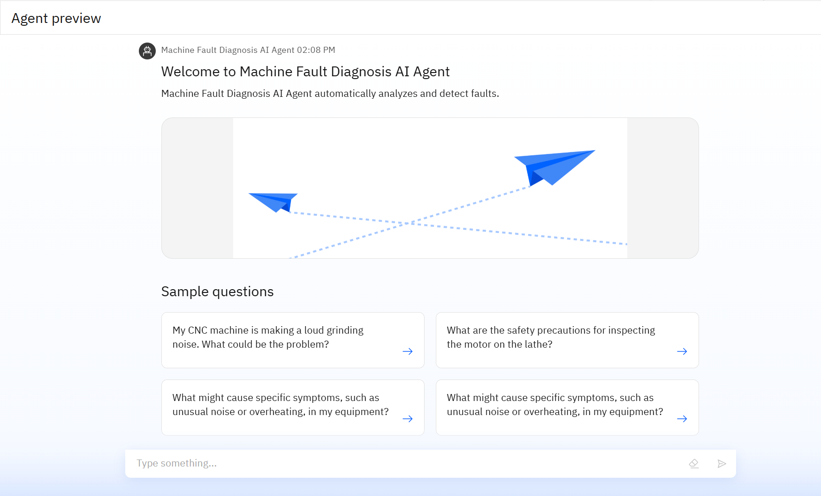
Results

Slide 9
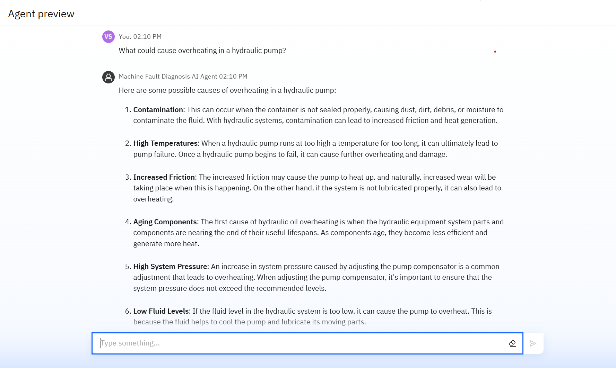
Results

Slide 10
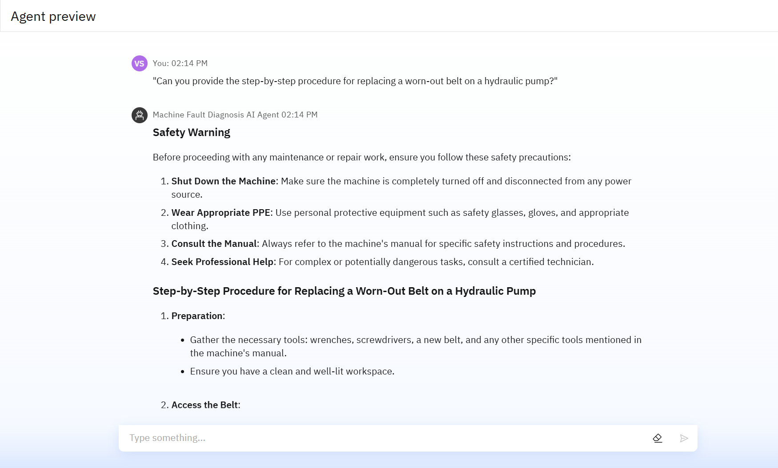
Results

Slide 11
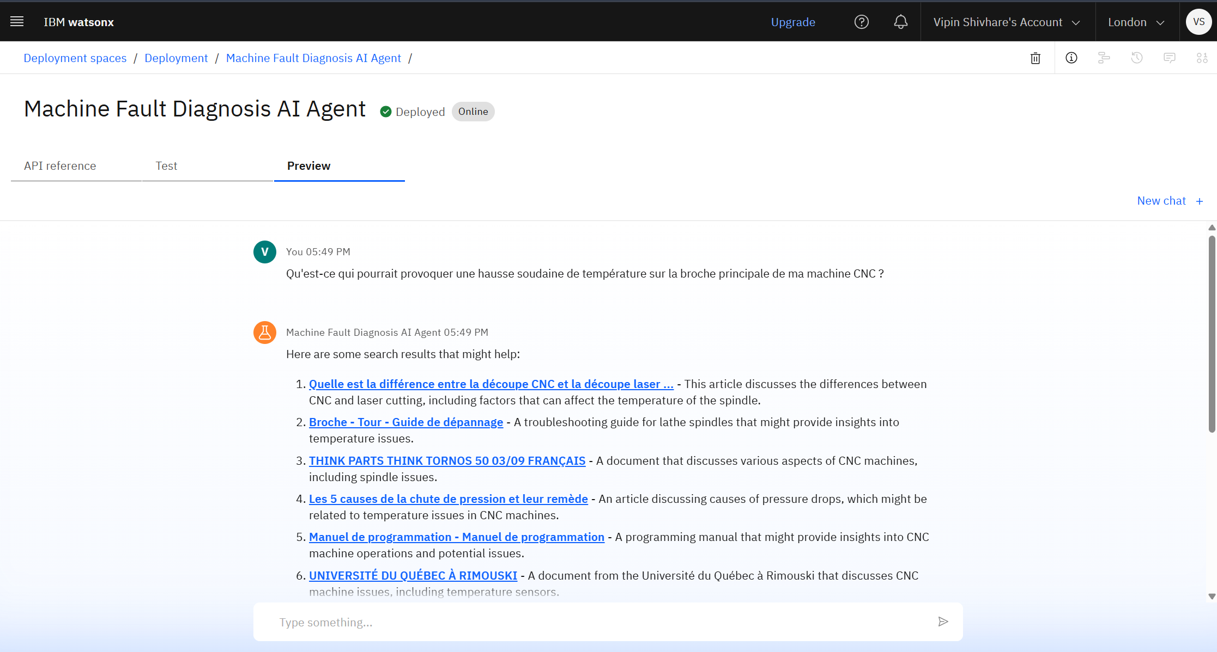
Results
Deployed AI Agent

Slide 12
Conclusion
The Machine Fault Diagnosis Agent empowers operators with AI-driven, real-time fault analysis and maintenance support.
This project demonstrates the power of integrating Agentic AI with cloud-based services to solve tangible industrial problems. By creating a scalable and cost-effective solution using IBM's free-tier offerings and the powerful Granite model, we can empower a new generation of technicians and small business owners to be more efficient, safer, and more productive.
This work showcases a practical application of machine learning that bridges the gap between theoretical AI concepts and real-world industrial needs.

Slide 13
GitHub Link
https://github.com/imvin1/Machine-Fault-Diagnosis-AI-Agent/tree/main

Slide 14
Future scope
Enhanced Multimodal Support: Integrate visual and auditory analysis, allowing the agent to diagnose faults from uploaded images of machine damage or recordings of unusual noises.
Advanced Sensor Integration: Connect with real-time IoT sensors for continuous monitoring of an expanded range of parameters like fluid levels, pressure, and electrical currents.
Interactive 3D Schematics: Provide users with interactive 3D models of machine parts, highlighting the location of a diagnosed fault and illustrating repair steps.
Augmented Reality (AR) Guidance: Develop an AR overlay for smartphones or smart glasses that guides technicians through complex repair procedures in real-time
Automated Report Generation: Automatically generate comprehensive diagnostic reports after each interaction, summarizing the fault, recommended actions, and safety measures for record-keeping.
Personalized Training Modules: Develop personalized training content for technicians based on recurring issues or common maintenance tasks for specific machines they operate.
Natural Language Voice Interface: Implement a robust voice-activated interface, enabling technicians to interact with the agent hands-free while working on the shop floor.

Slide 15
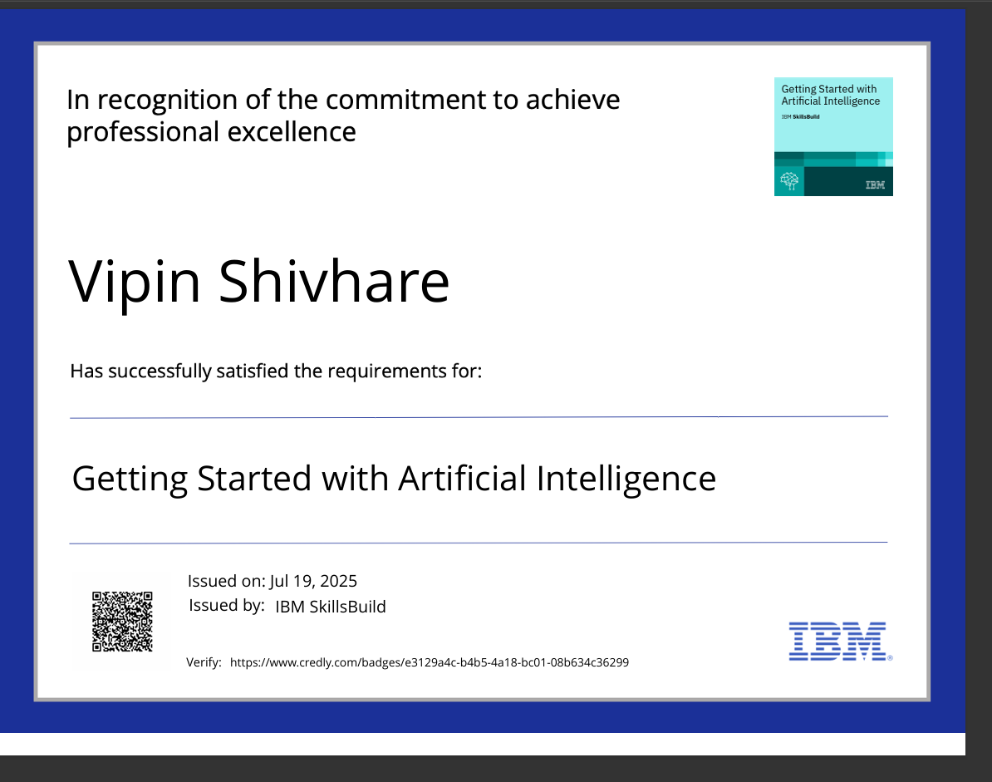
IBM Certifications
Screenshot/ credly certificate (getting started with AI)

Slide 16
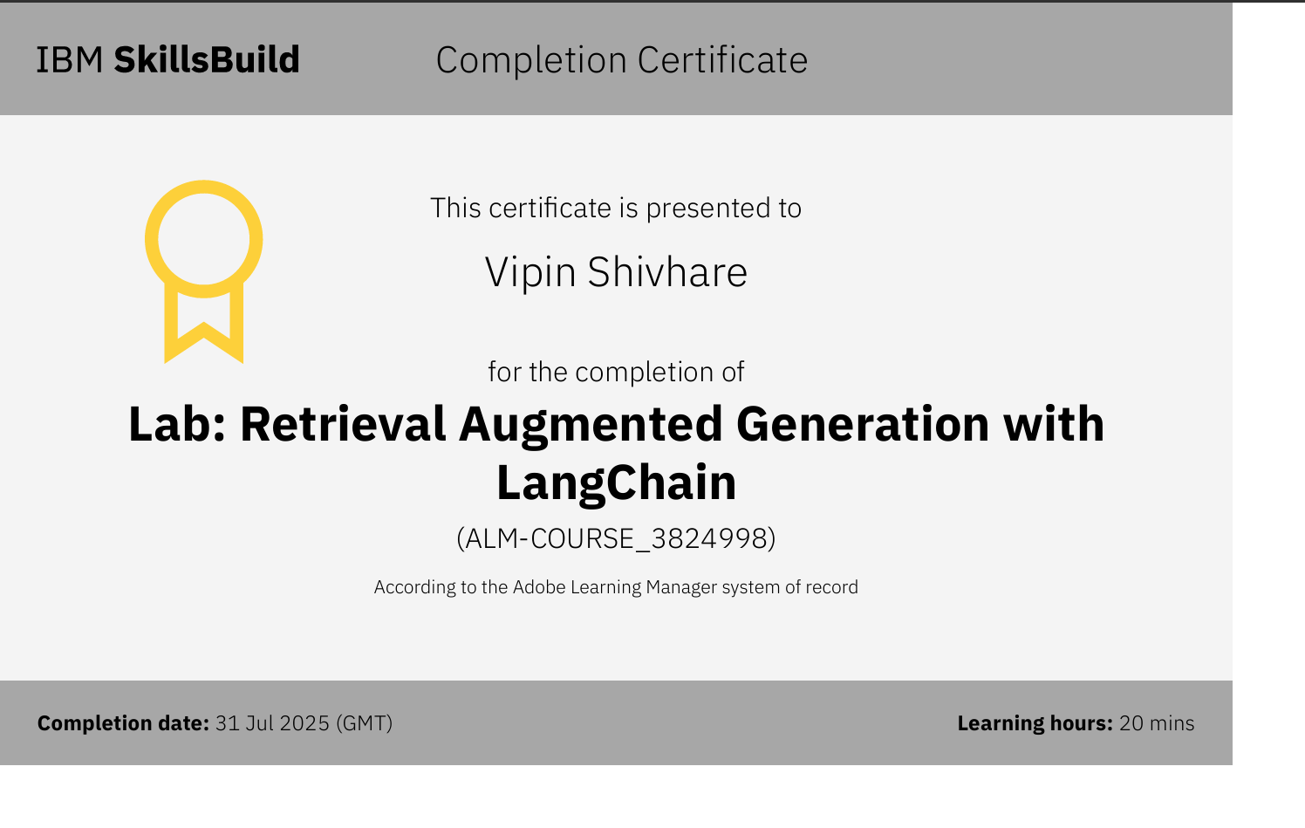
Attach your RAG LAB certificate here

Slide 17
THANK YOU

